Slide 1
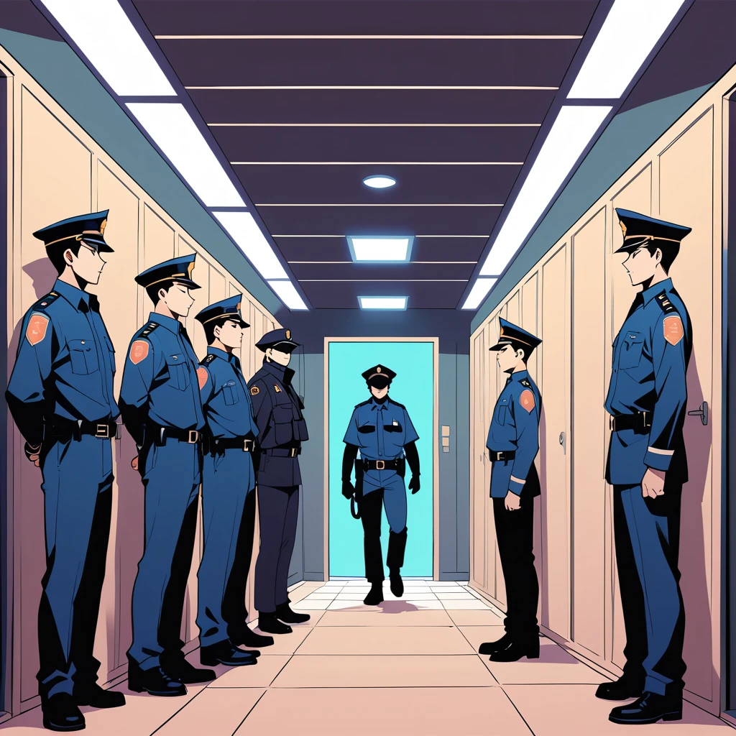
MY FIRST DAY AT WORK
POLICE OFFICER

Slide 2
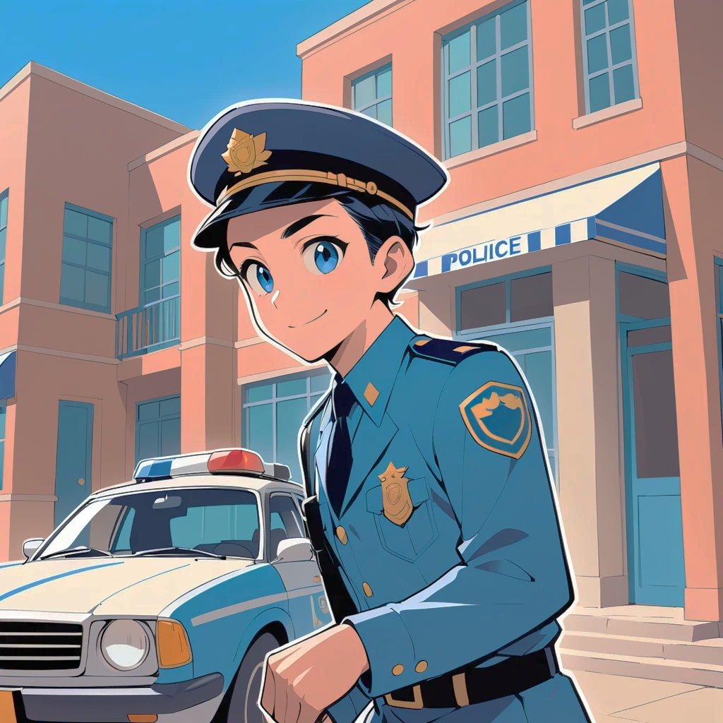
MY FIRST DAY AS A POLICE OFFICER
I WORKED AT THE POLICE STATION AND I VISITED THE PARKING LOT
I FELT NERVOUS AND EXCITED AT THE SAME TIME

Slide 3
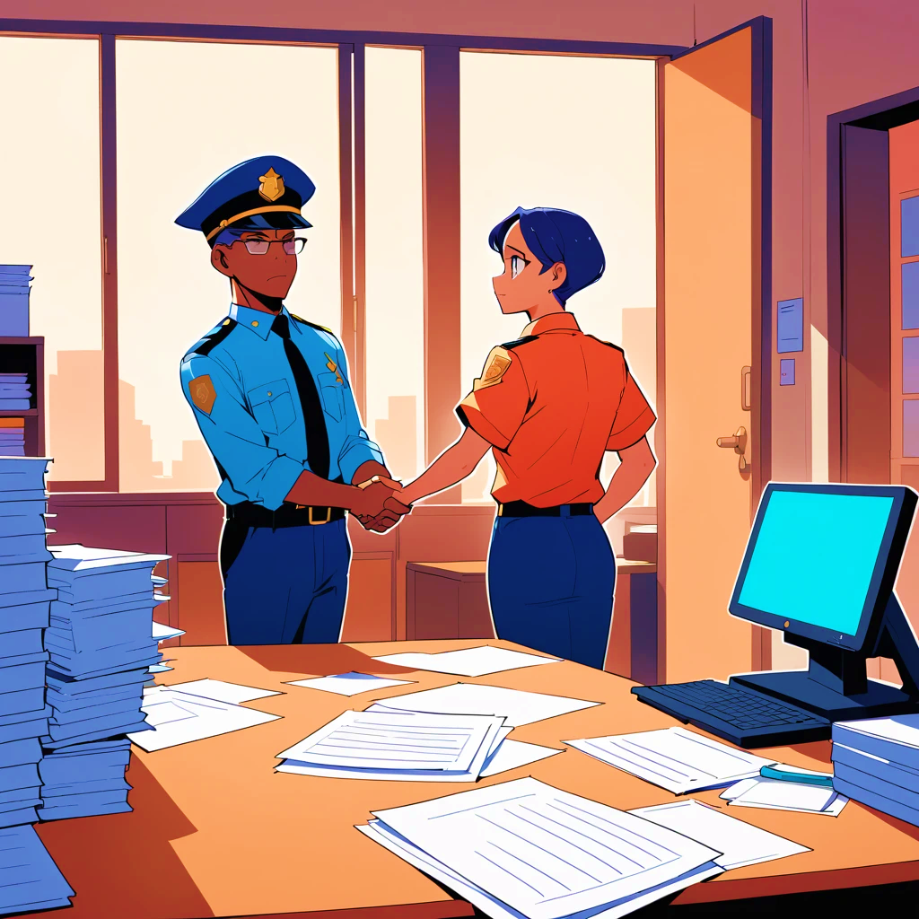
I MET CHIEF OFFICER WILKINS IN THE MORNING AND OFFICER ANDREWS AFTER THE LUNCH
I TALKED WITH OTHER COLLEAGUES AND I SAW A CRIMINAL

Slide 4
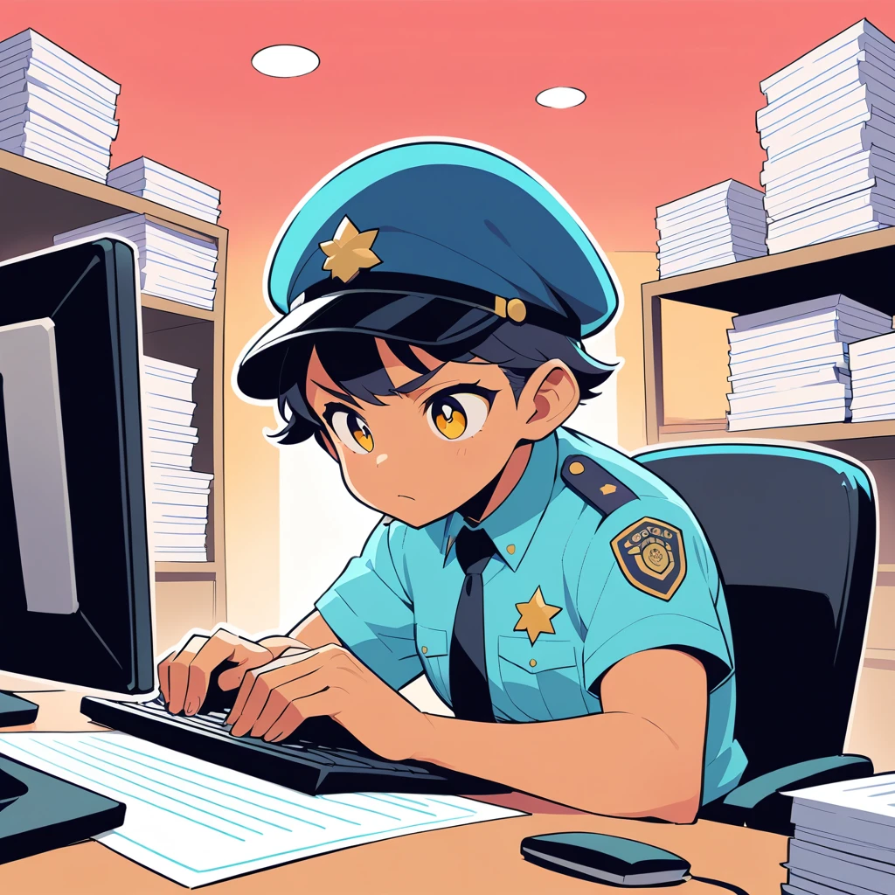
I FILLED IN LOTS OF DOCUMENTS. I WAS PATROLLING THE CITY TOO
I AM A WELL ORGANIZED PERSON AND VERY DISCIPLINED

Slide 5
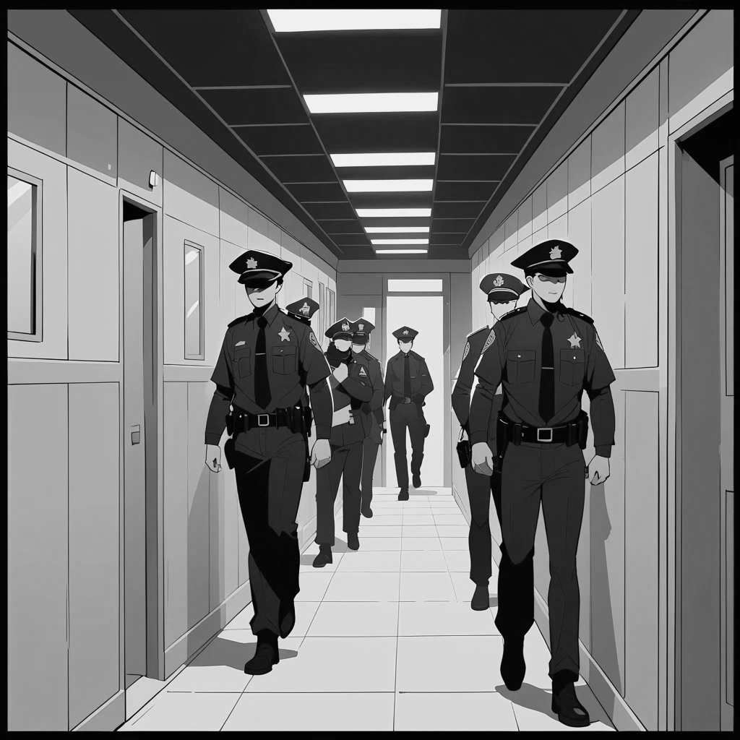
I THINK I AM A VERY ACTIVE AND FRIENDLY PERSON
I STUDIED AT THE POLICE ACADEMY AND TOOK SEVERAL COURSES ABOUT GUNFIGHT, TACTICS AND INTERROGATION METHODS

Slide 6
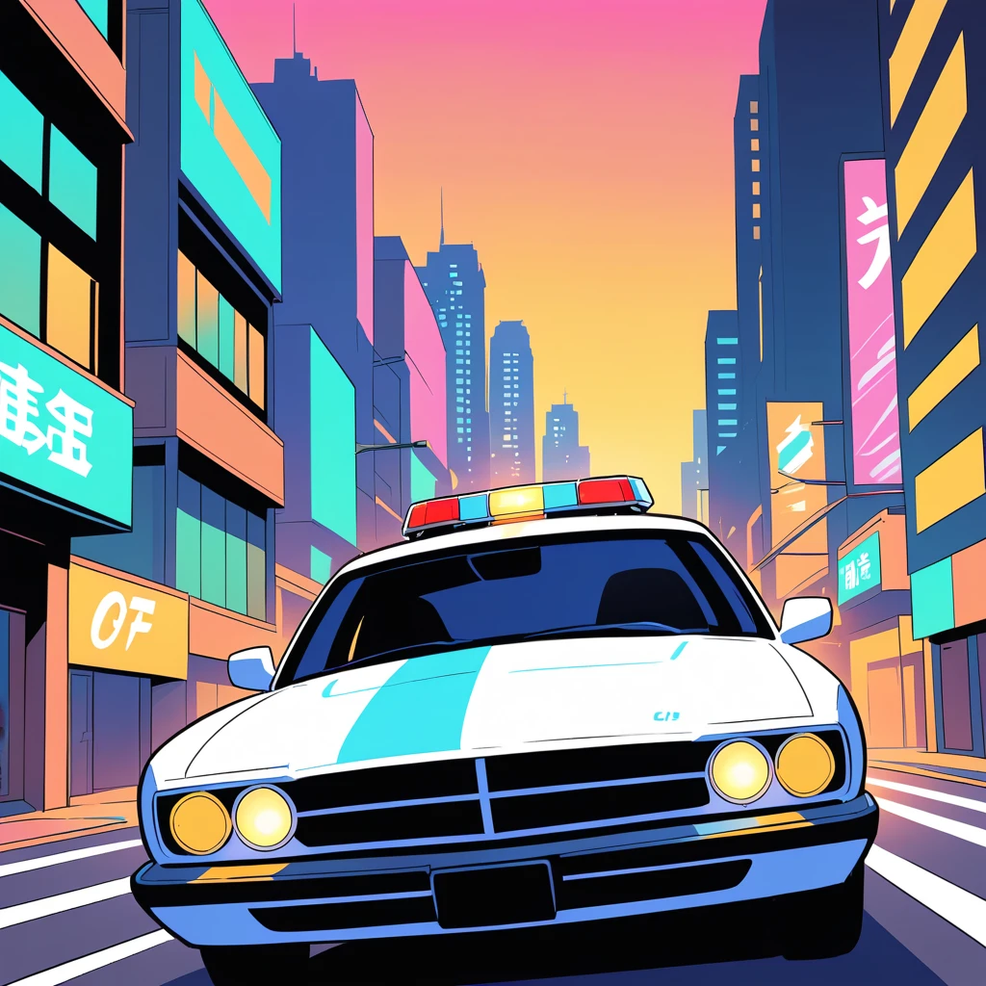
WHAT I LOVED ABOUT THIS JOB IS HOW EXCITING IT CAN BE
WHEN I’M NOT WORKING I LIKE TO GO DRINK SOME BEERS AND WATCHING MOVIES

